Slide 1
Gamified Idea Generation
Theme : Open Innovation
A Promising Future for Brainstorming
By
Team Name : Master Mind achievers

Slide 2
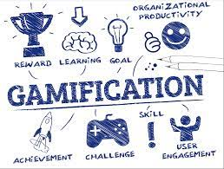
The Challenge of Brainstorming**
Introducing Gamification**
Traditional brainstorming can be :
Unstructured and chaotic
Prone to dominance by a few individuals
Lacking in engagement and motivation
Gamification incorporates game-like elements into non-game contexts
Can increase engagement, motivation, and participation

Slide 3

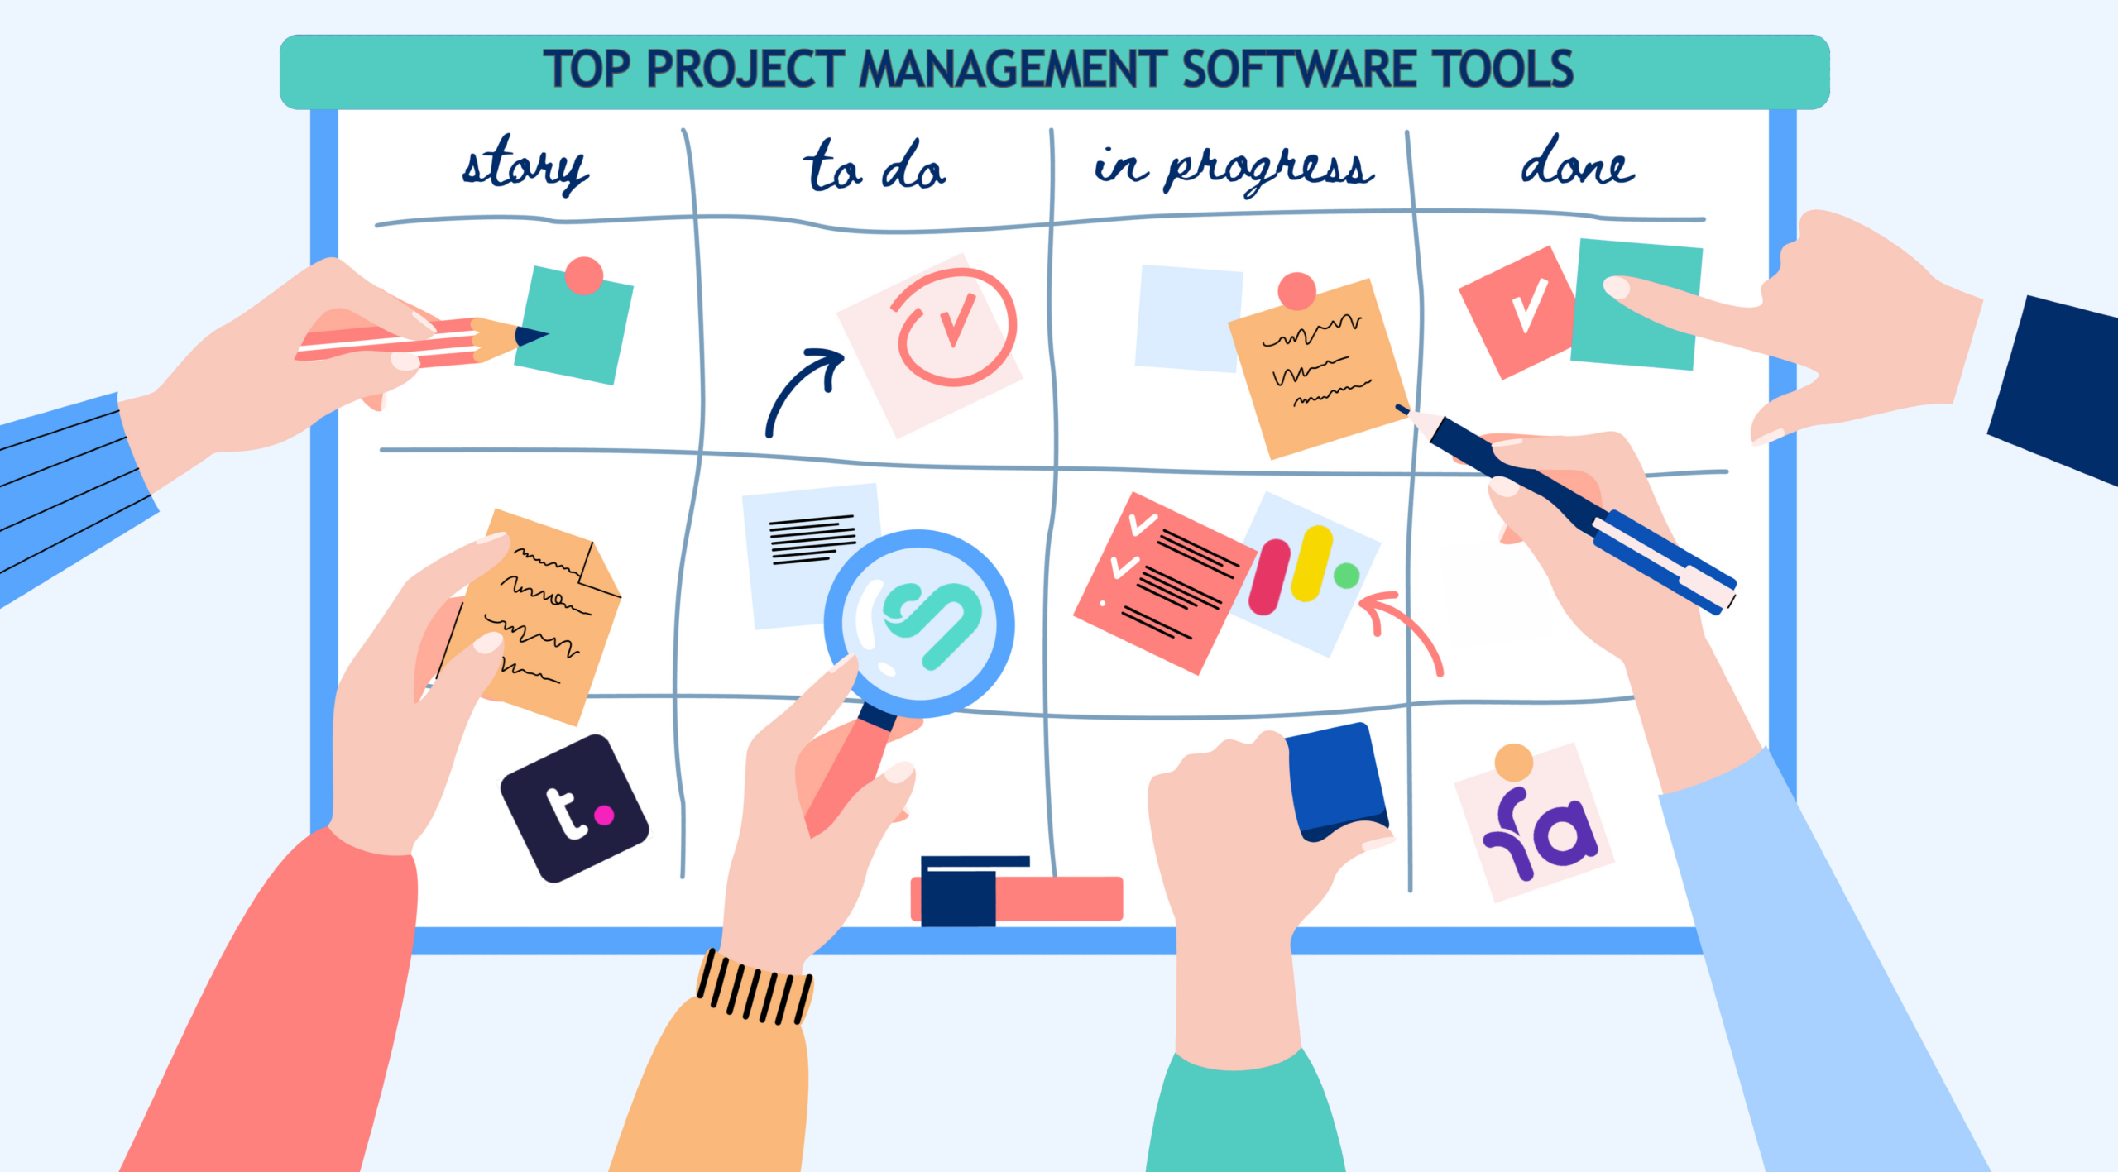
Examples of Gamification in Existing Tools**
Online collaboration tools:
Allow for visual brainstorming and idea sharing
Enable voting on ideas and tracking progress
Project management tools:
Facilitate task assignment and deadline setting
Promote teamwork and collaboration

Slide 4

Benefits of Gamified Idea Generation**
Increased engagement and participation
Enhanced collaboration and teamwork
Boosted motivation and morale
Improved quality and quantity of ideas

Slide 5
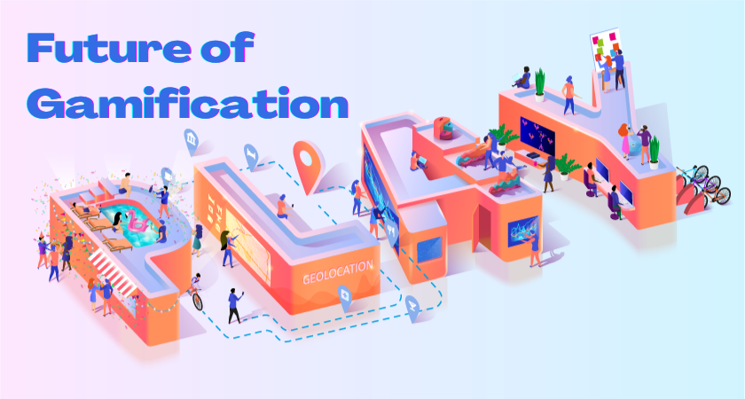
The Future of Gamified Brainstorming**
Gamified platforms hold promise for the future of idea generation
Potential to revolutionize brainstorming and innovation

Slide 6


